Slide 1

Rocket Flight Computer
Team Apogeenius
Tannyr Singleterry (L)(CMPEN)
Gannon Bird (EE)
Ethan Benne (EE)
Nathan Emerson (CMPEN)

Slide 2
Objectives

Slide 3
Significance and Novelty

Slide 4
Requirements
The ID table thing goes here for requirments

Slide 5
Approach - Microcontroller

Slide 6
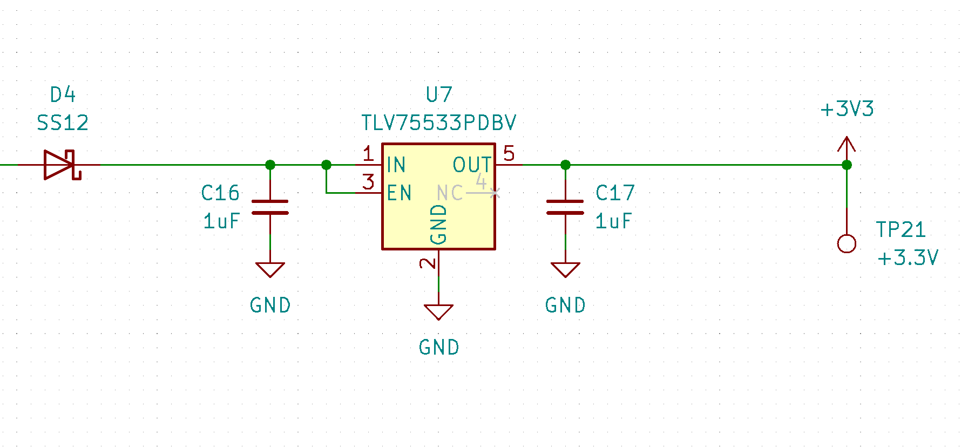
Approach - Power Efficiency
Limited consideration for Sensor Test Board
Currently using Ultra Low Dropout Linear Regulator
Once we have power consumption of sensor test board the need for a Switching Mode Power Supply (SMPS) Topology will be explored.

Slide 7
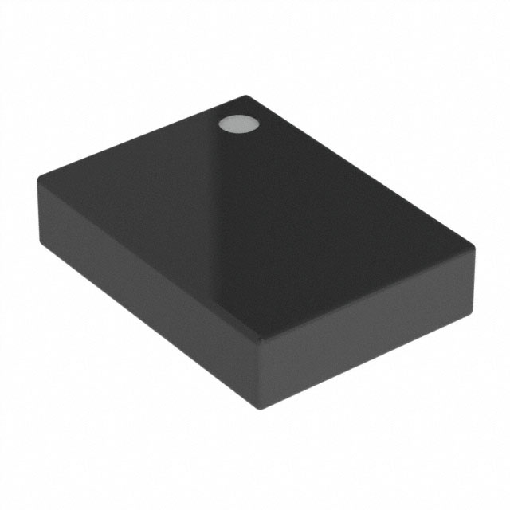
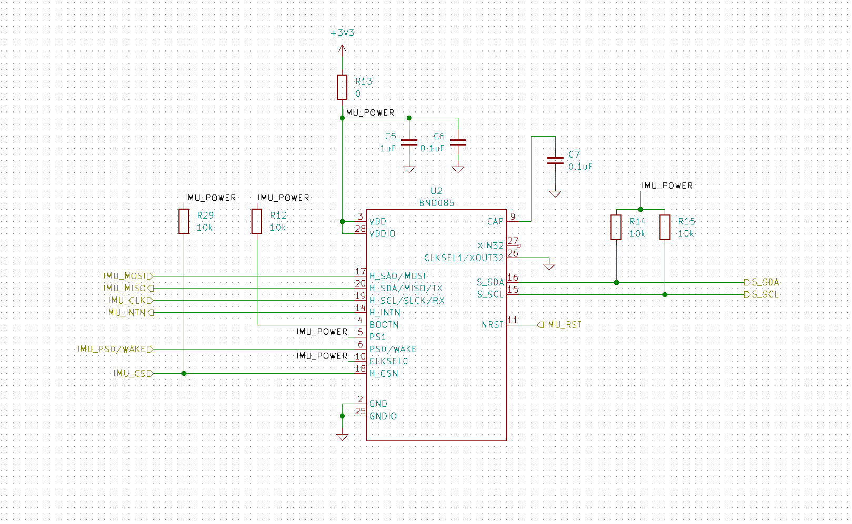
Approach - IMU
BNO085 – Intelligent 9-axis Inertial Measurement Unit (IMU)
Low G Accelerometer, Gyroscope, and Magnetometer
Contains on chip signal processing and filtering for 3D orientation and position
Supports additional sensors through secondary I2C bus connection
Used in application such as Tablets and VR/AR motion trackers

Slide 8
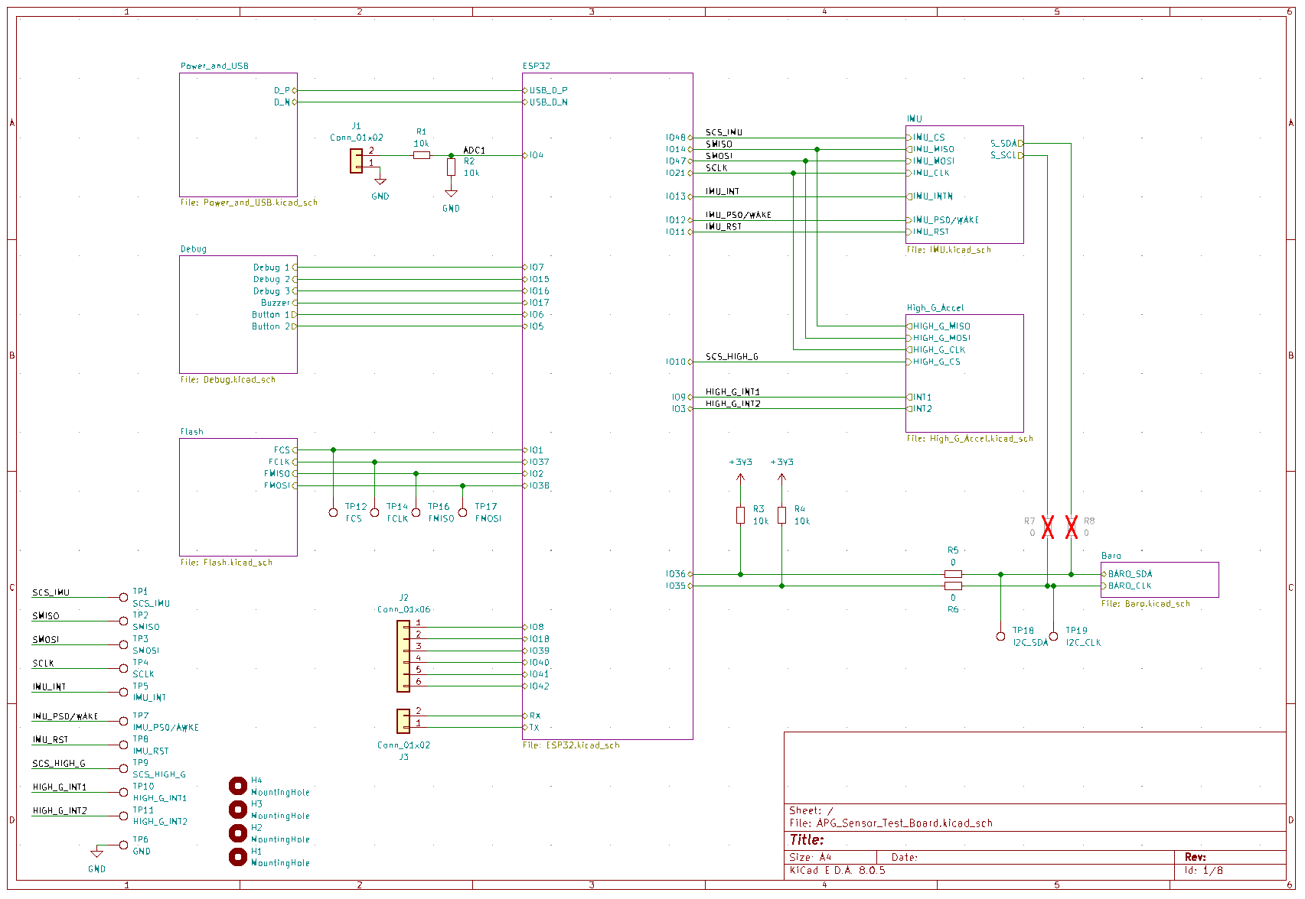
Approach – PCB Design
Designed in KiCAD, board manufactured and populated by JLCPCB
Hierarchical design, each member design at least one schematic
Switched from initial IMU pick to another to avoid level shifting data line

Slide 9
Approach – UML?

Slide 10
Approach - Webpage

Slide 11
Approach - Standards

Slide 12
Procedure

Slide 13
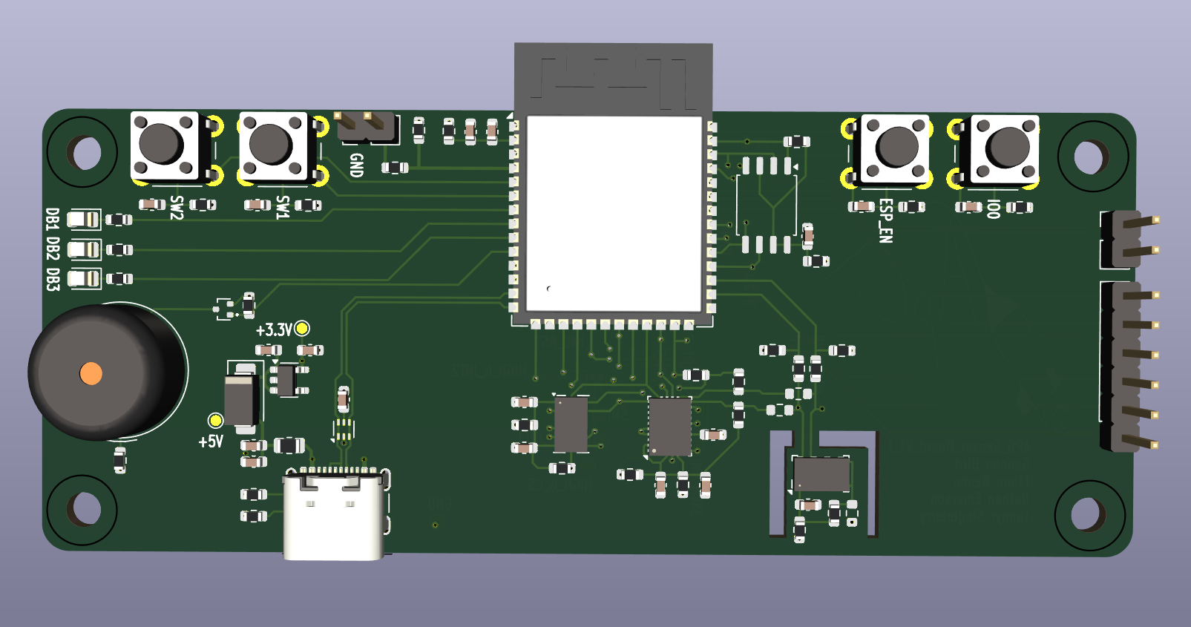
Testing Board
Large breakout of all sensors to allow for code development on hardware
Includes additional debug buttons, LEDs, and jumper configurable connections for testing
All extra µC pins expressed to Headers

Slide 14
Verification Plan

Slide 15
Budget

Slide 16
Gantt Chart

Slide 17
Work Breakdown

Slide 18
Feasibility Assessment

Slide 19

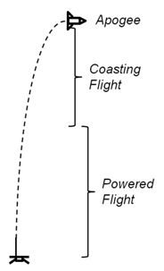

Questions
Image Credit: https://ffden-2.phys.uaf.edu/webproj/211_fall_2014/Adam_Kurzbard/Adam_Kurzbard/Page4.html

